Slide 1
Packet Sniffers
MEMBERS:
Colin Anderson, Justin Bell, David Lisiewski, Nick Peterson
Notes:
Nick

Slide 2
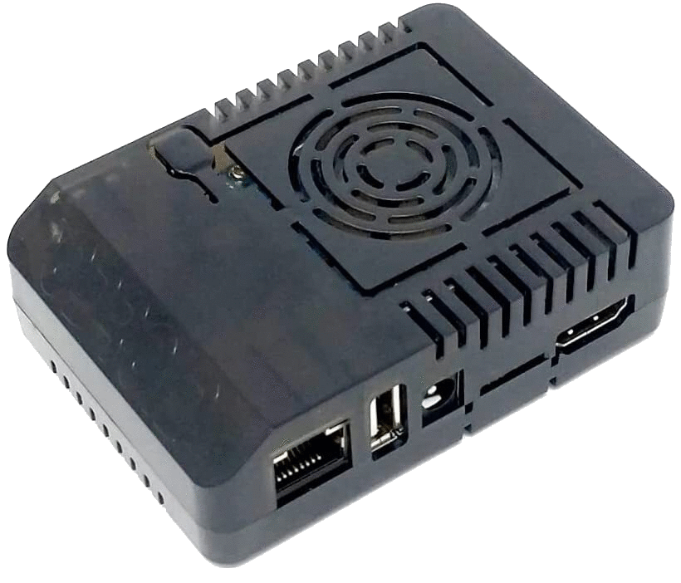
What is it?
We created a versatile device that has a mix of Red and Blue Team applications
Ability to capture, decrypt, manipulate, and redirect network traffic
Provides remote connectivity to transfer packet captures to personal device

Slide 3







Tools
BetterCap
ARP/DNS Spoofing
Apache2
Webpage Redirection
MITMProxy
Local Root Certificates
Proxy Servers
OWASP ZAP
Certificate Testing
Packet Collection
Aircrack-ng
Wifi Hacking

Slide 4
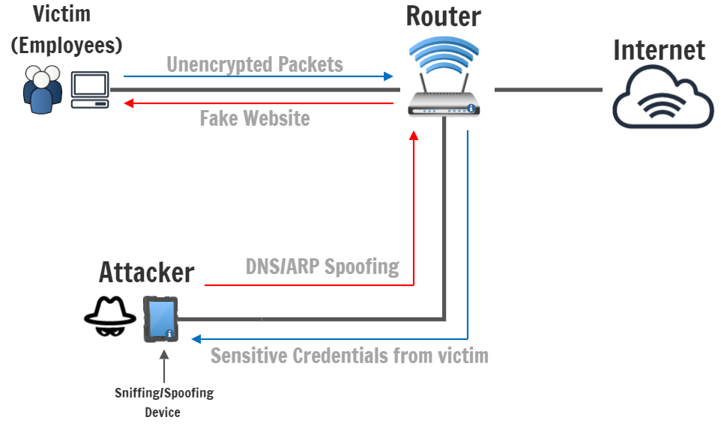
What is spoofing?
ARP?
DNS?
Intentionally identifying as or impersonating something else
Also called ARP Cache, is the Address Resolution Protocol, which is a table of IP addresses that are resolved to MAC addresses
192.168.1.1 ←→ 00-23-70-ac-79-4d
Domain Name System, a distributed naming system for computers
www.google.com ←→ 172.217.2.36
Notes:
David

Slide 5
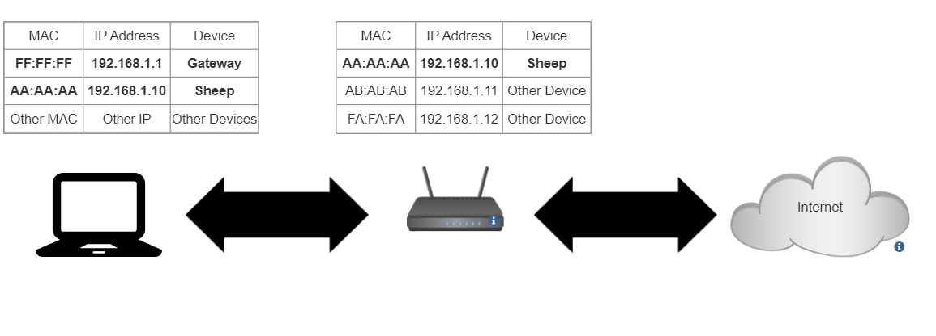
Normal ARP Table in a Network
Notes:
colin

Slide 6
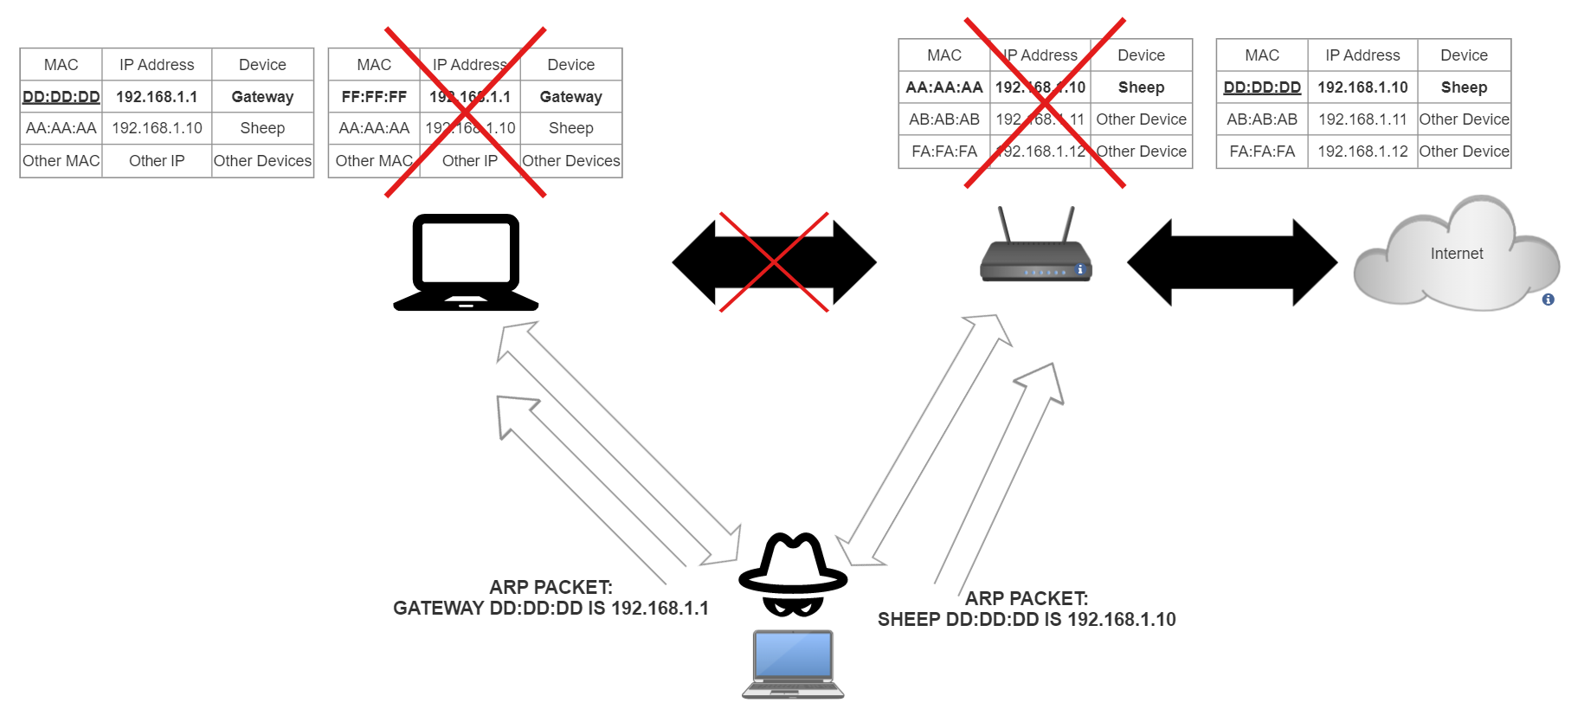

Slide 7
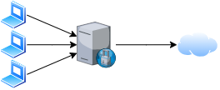
Local Certificates, Proxies, and HSTS
Local Certificate Authority: Issue certificates to computers connected to the forward proxy server
Forward Proxy Server: sits between a client and the internet, forwarding requests to the internet server
HSTS: HTTP Strict Transport Security, which prevents redirects from HTTPS to HTTP
Forward Proxy Diagram

Slide 8
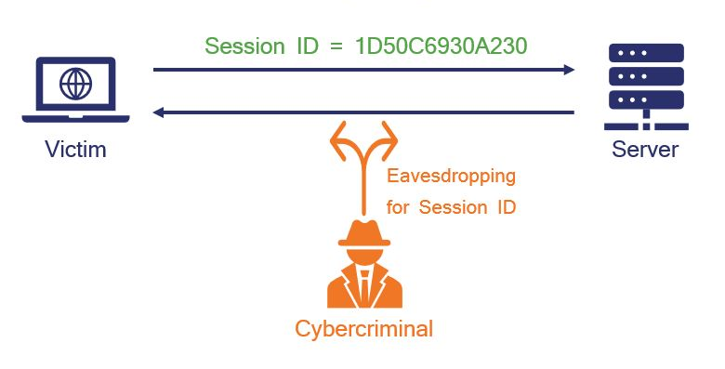
Session Hijacking
TheSSLStore

Slide 9
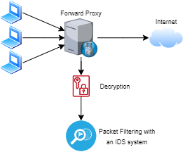
IDS System with Forward Proxy Server

Slide 10
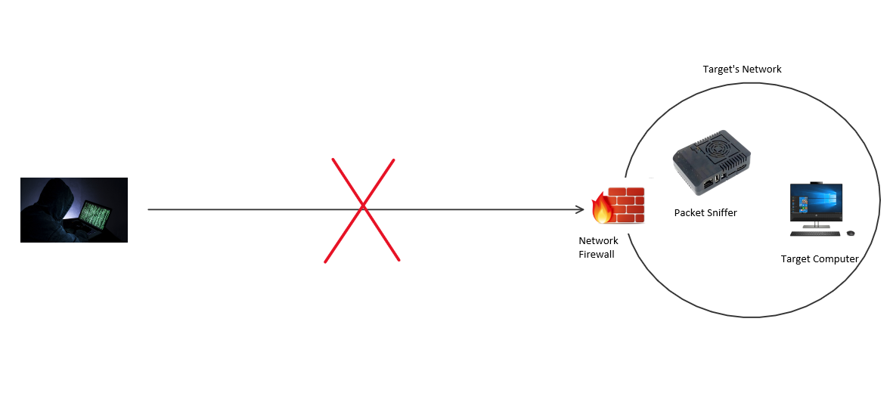
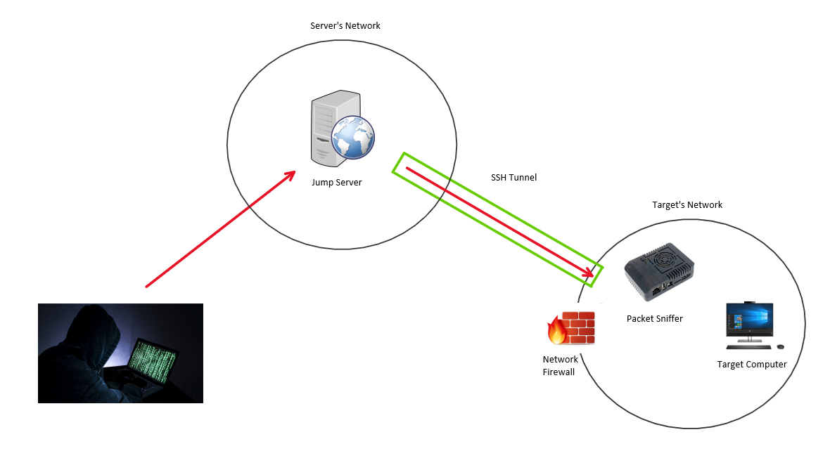
Reverse SSH Tunneling
A reverse ssh tunnel is great as a red team exfiltration technique as it allows a way to bypass a target network’s firewall, control the Packet Sniffer and move and data you may need offsite for further analysis.

Slide 11
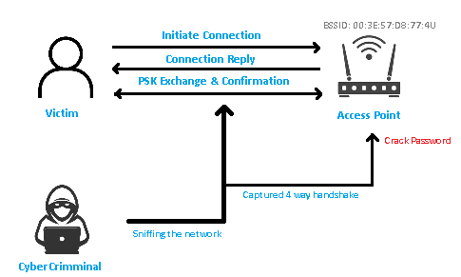
Wifi Hacking
Attacker scans for network access points.
Attacker accesses BSSID (basic server set identifier).
Attacker starts a 4-way capture.
Victim connects to access point.
Attacker captures the WPA/WPA2 Handshake.
Attacker runs password cracking tool with wordlist.

Slide 12
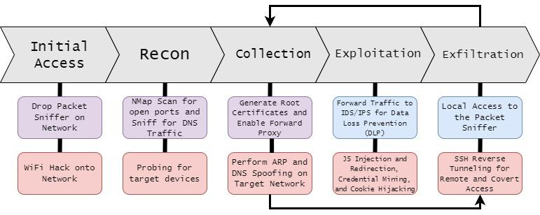
Attack Chain

Slide 13
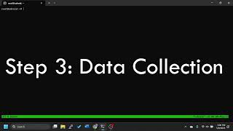
Demo

Slide 14
Questions?

Slide 15
Here are some of the capabilities of the Packet Sniffer!

Slide 16
What’s Next?
Implement WiFi hacking capabilities of target networks to allow credential harvesting
Introduce an Intrusion Detection and Prevention system for Data Loss Prevention (DLP)
Create both a Intrusion Detection System (IDS) and Intrusion Prevention System (IPS) specialized for our device
Notes:
Justin

Slide 17
The Packet Sniffer
The packet sniffer is a device that will be able to:
Intercept/collect network traffic
Modify/redirect web page requests
Preform ARP/DNS spoofing
Transmit data to attacker’s remote device
WiFi Hacking of other networks
Notes:
David

Slide 18
ARP Spoof (MITM) Attack
Notes:
colin

Slide 19
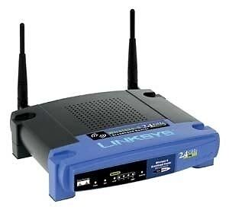
What tools do we use?
Tools we have used:
Dsniff - Collection of network tools
Pi-Hole - Network and DNS managing software
Bettercap - Another collection of network, proxy, and DNS tools
Ubuntu VM on VMware
Wireshark - Network packet analyzer
Physical NAT (Maybe include picture/model number) with DDWRT which gave additional customization
Suricata - Network Traffic experimentation/Filtering
Notes:
Nick

Slide 20

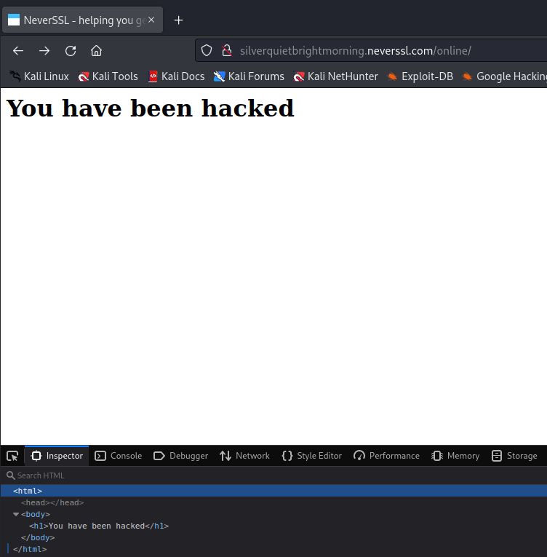
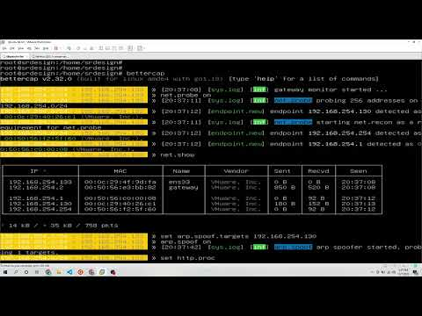
Web Traffic Capture/Modification
Notes:
Justin

Slide 21

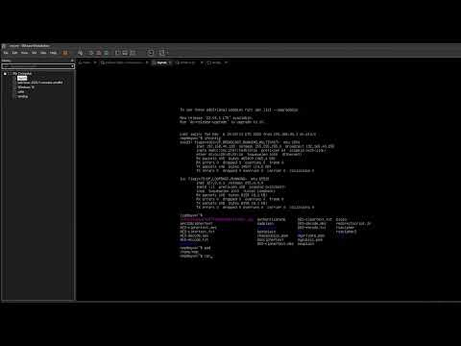
Web Redirection
Notes:
Nick

Slide 22
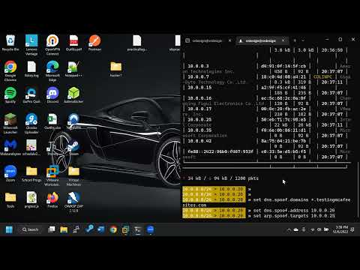
ARP/DNS Spoofing Demo

Slide 23


Constraints & Roadblocks
Decrypting Victim Data
HTTPS data (information can’t be decrypted without a certificate)
Operating System instability
Ubuntu crashing/soft CPU lockup
Inconsistent DNS Spoofing
Network Configuration (DNS) setup
Internet connectivity
Arp spoofing was overloading the network
Notes:
Justin

